Slide 1
Employee Future salary prediction
CAPSTONE PROJECT
Presented By:
1. Vajinapalli Abhinav - SR University - CSE AIML

Slide 2
OUTLINE
Problem Statement (Should not include solution)
System Development Approach (Technology Used)
Algorithm & Deployment (Step by Step Procedure)
Result
Conclusion
Future Scope(Optonal)
References

Slide 3
Problem Statement
Predicting employee salary is extremely useful in HR budgeting and forecasting.
The goal is to project an employee's future 5-year income based on aspects of present income, experience, education, job level, etc.
This helps organizations to understand likely financial burdens.
Salary forecasting in real-time assists in career development planning of an employee.
Manual projections are employed in conventional methods; ML provides precision and automation.

Slide 4
System Approach
System requirements:
Laptop
Google Colab / Jupyter Notebook
Python 3
Library required to build the model:
python
pandas, numpy
scikit-learn
seaborn, matplotlib

Slide 5
Algorithm & Deployment
Step 1: Load dataset (CSV)
Step 2: Preprocessing of data (process categories, missing values)
Step 3: Build future salary with growth rates
Step 4: Introduce noise for real-world variation
Step 5: Train Random Forest Regressor
Step 6: Model Evaluation (MAE, MSE, R², Custom Accuracy)
Step 7: Visualize using graphs (scatter plot, bar graph, violin plot)
Step 8: Try on new data

Slide 6
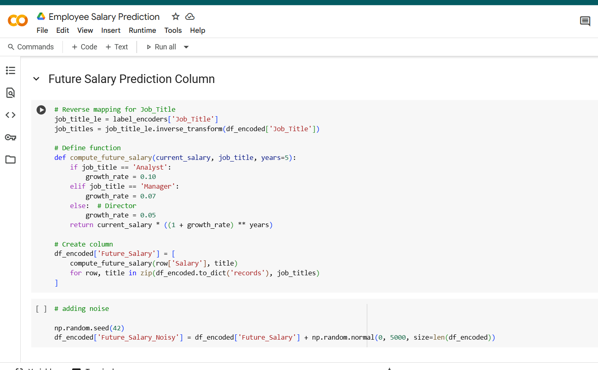
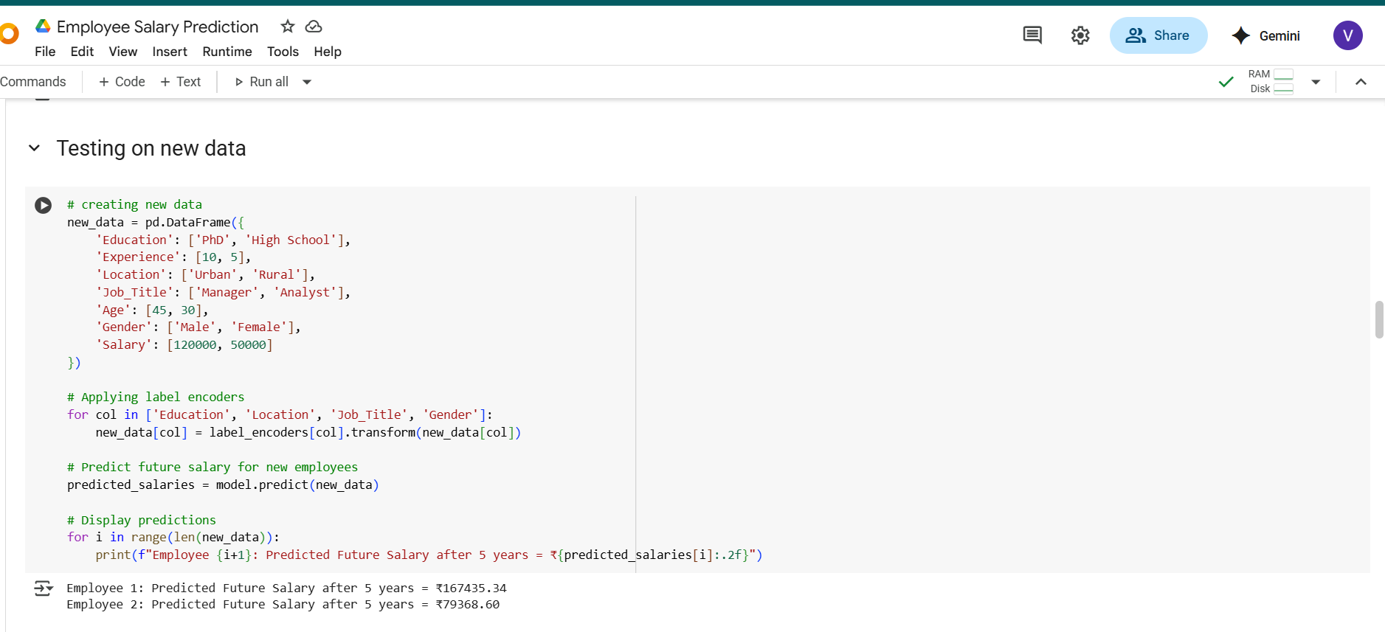
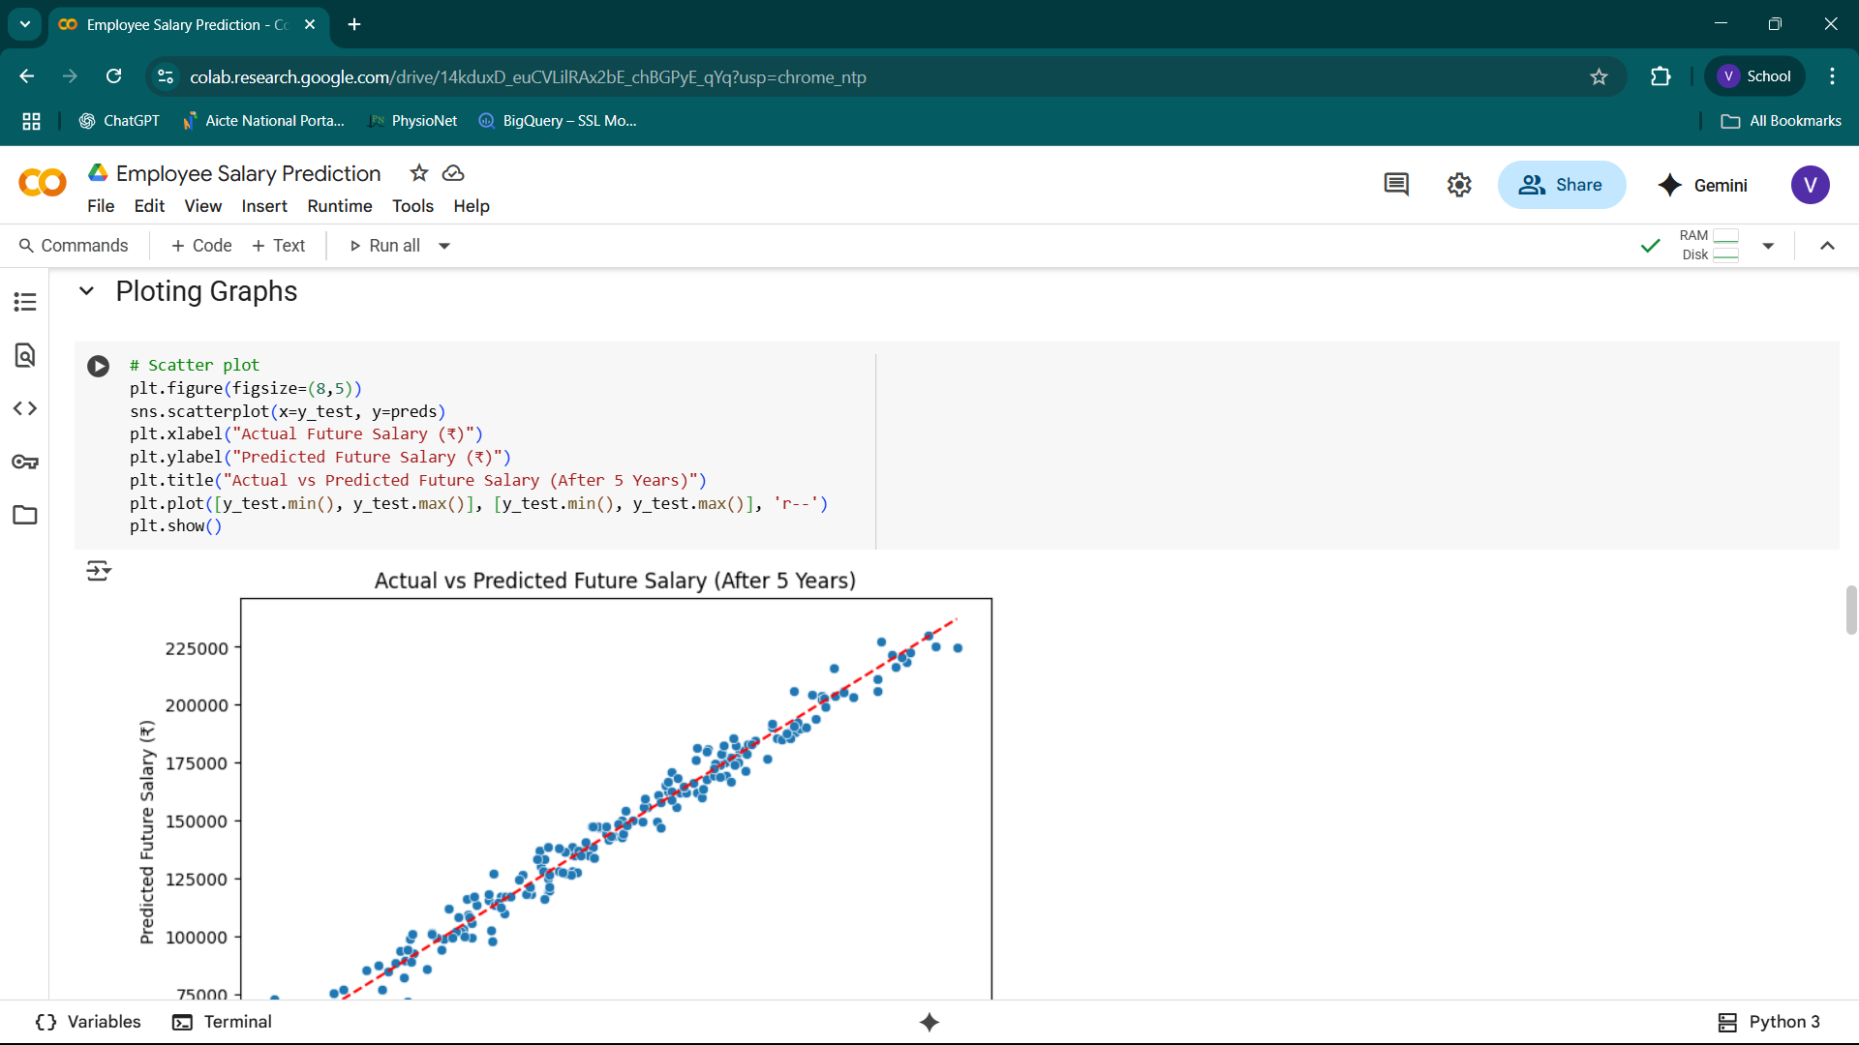
Result

Slide 7
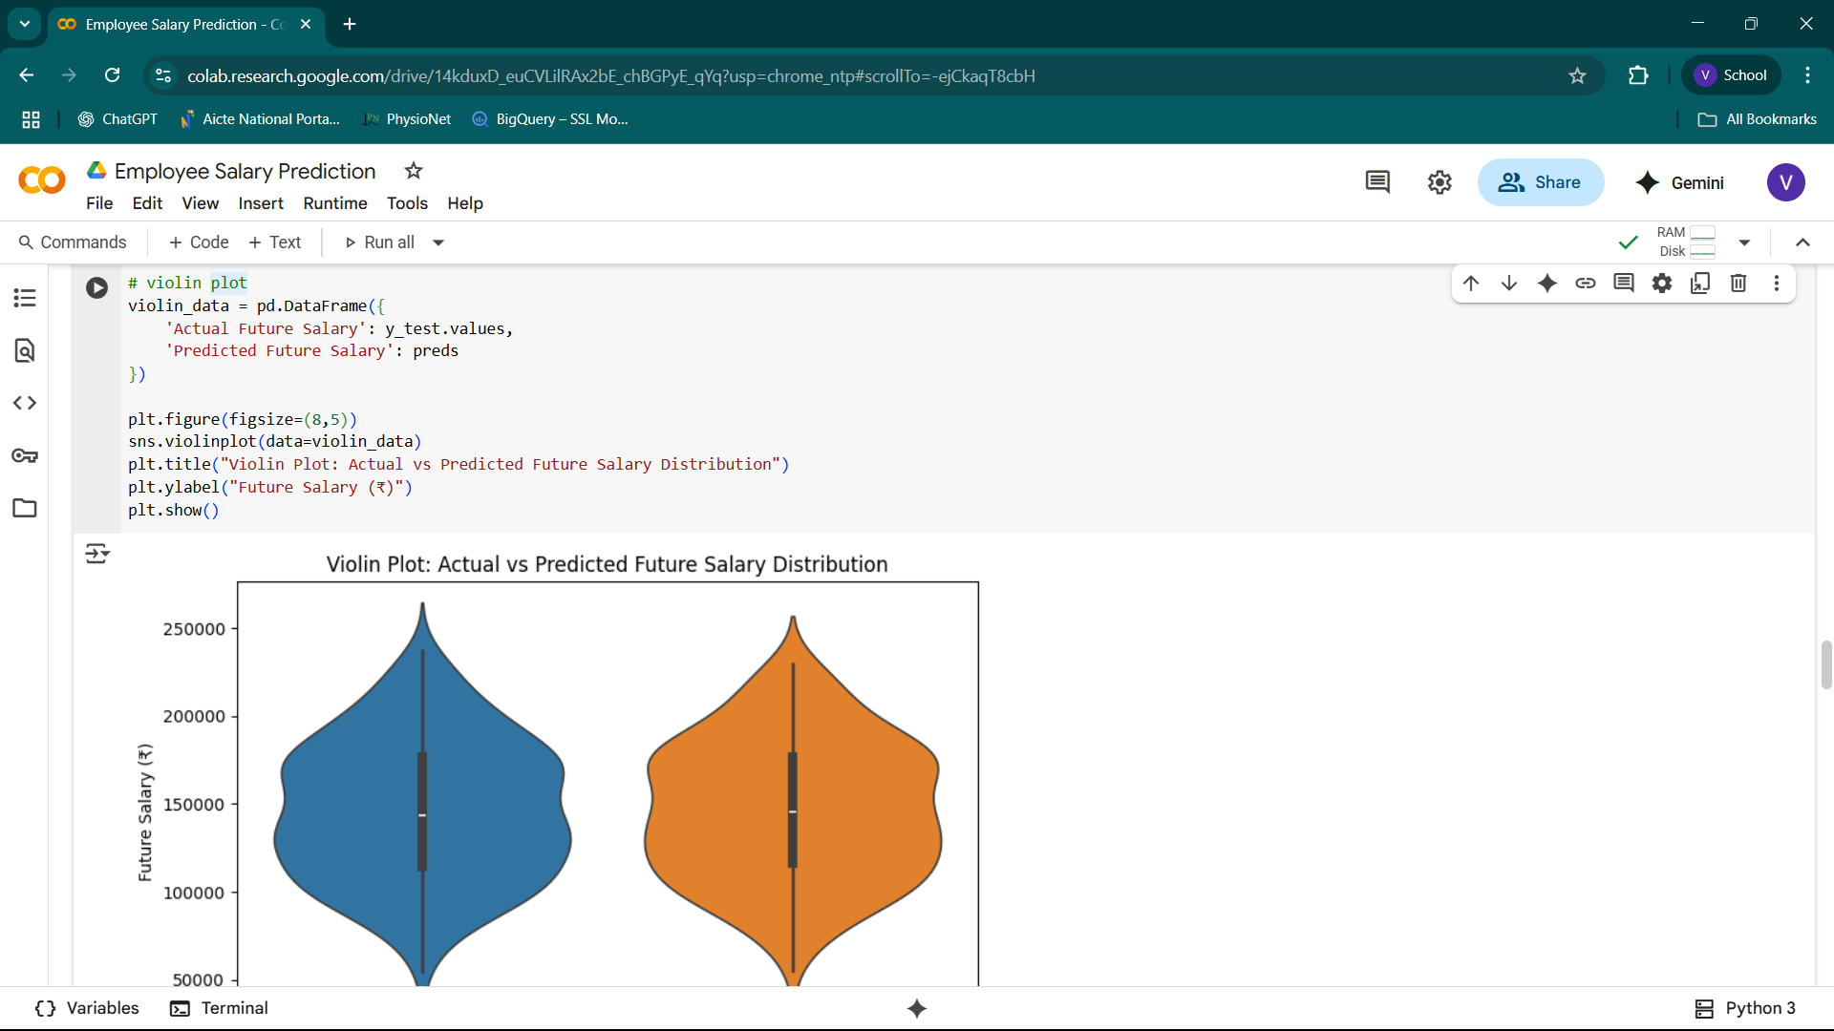
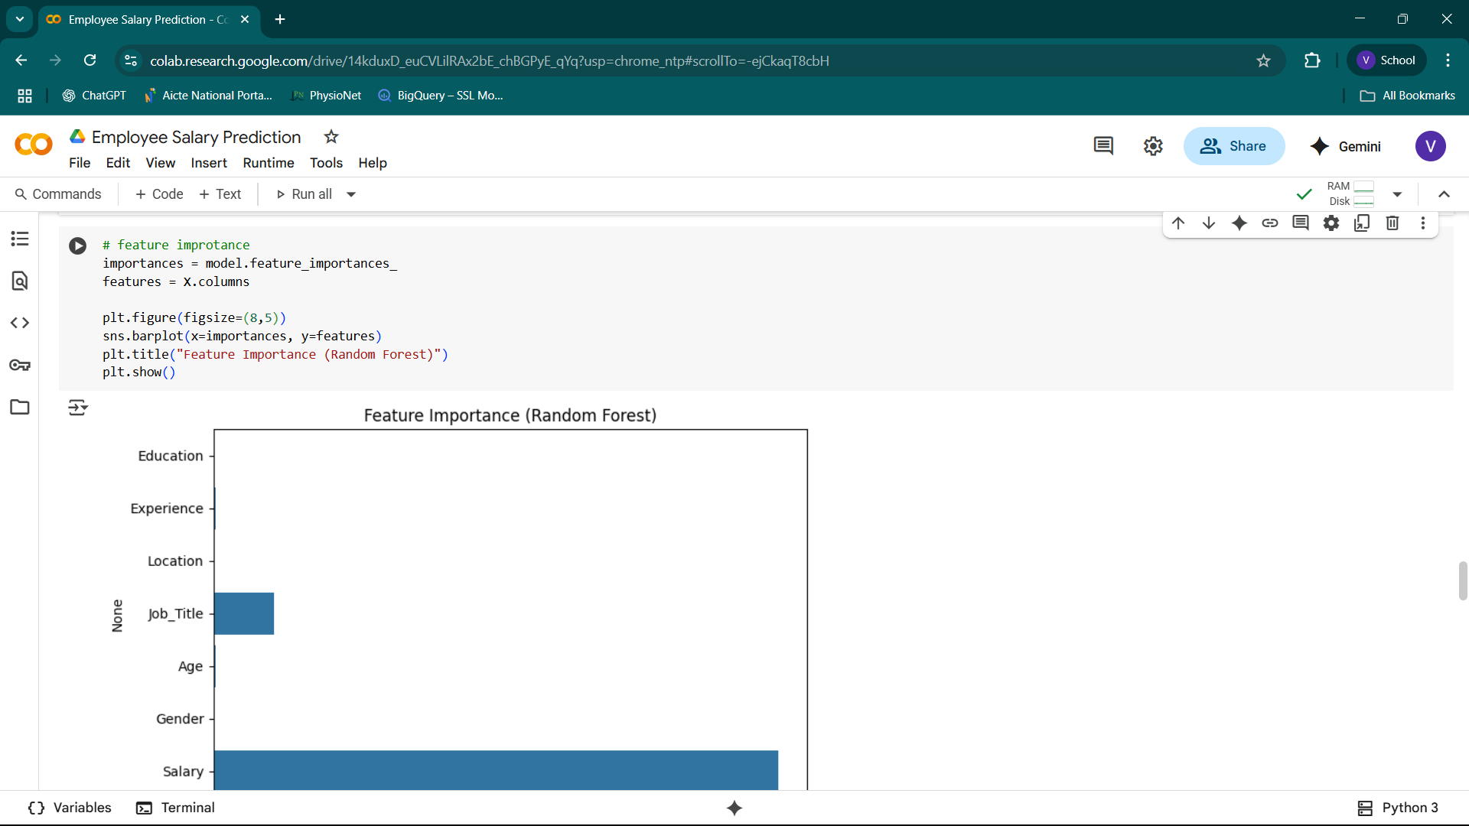
Result
https://github.com/2303A52486/Employee-Salary-Prediction.git

Slide 8
Conclusion
Forecast employee future salary accurately using Random Forest.
Attained high R² ~ 0.9.
Can be integrated with HR systems utilized for compensation planning.

Slide 9
Future scope(Optional)
Execute as a web application using Streamlit or Flask
Employ true real-world HR system data
Include Explainable AI (SHAP values)

Slide 10
References
Scikit-learn Documentation
Kaggle Datasets
Python Official Docs

Slide 11
THANK YOU

